Slide 1
Masters Project Update (24/07/2024)
Ben Russell

Slide 2

Database Development
Database is now complete.
Overview
Database is being stored on Google Drive (Cloud Storage being used since database is too large to store on disk)
Database generates validated realistic ECG signals and lots of copies of the clean signals corrupt with Electrode Motion Noise.
Data Files are saved in HDF5 format, this is an easy format to load into PyTorch for Algorithm Development.

Slide 3
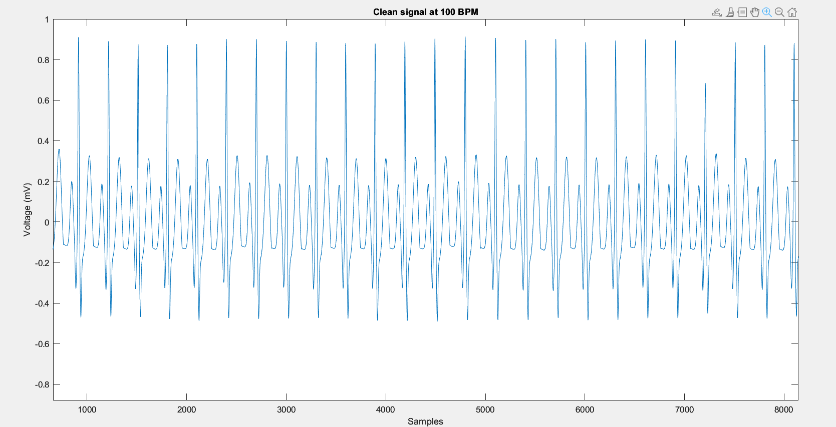
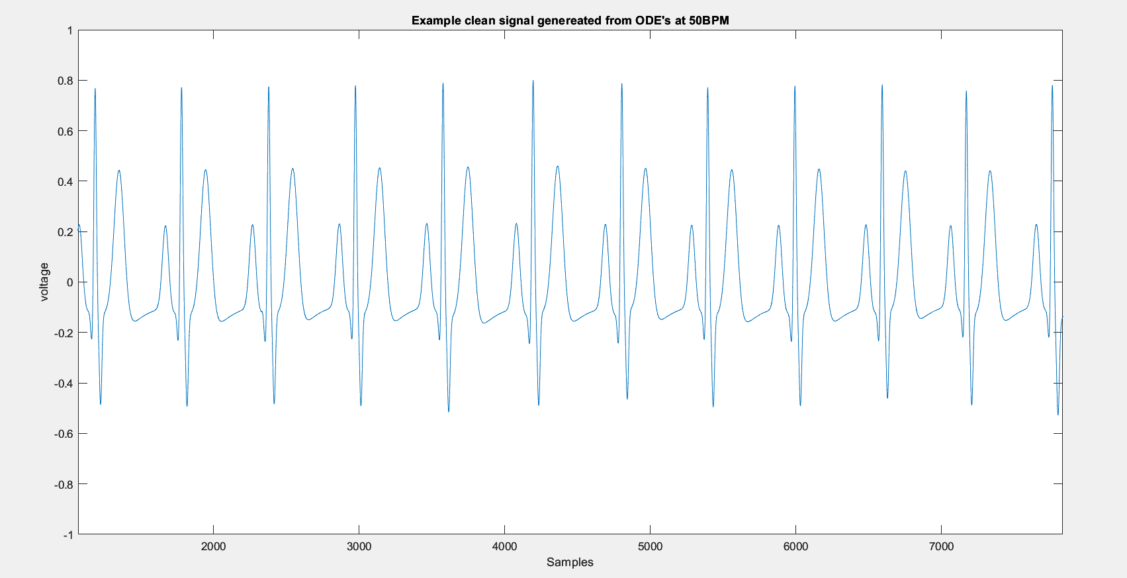
Database Examples (Clean Signals)
Each clean signal is generated at 50, 60, 70, 80, 90, 100 BPM.
This ensures a diverse range of HR’s are captured.
This can be increased, but significantly increases the complexity of the model.

Slide 4
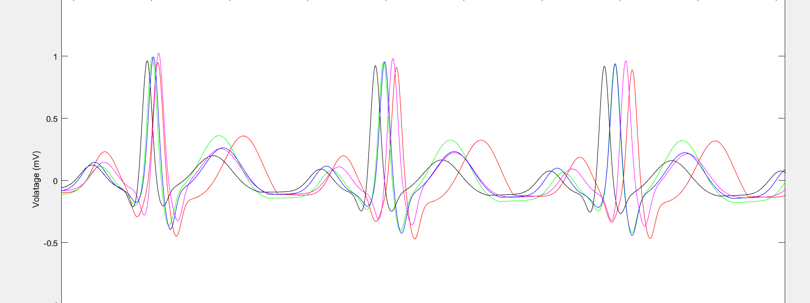
Database Examples (Clean Signal Morphology)
5 different clean signals at 100BPM. Note the difference in P, QRS and T waves adding variability into the training dataset.

Slide 5
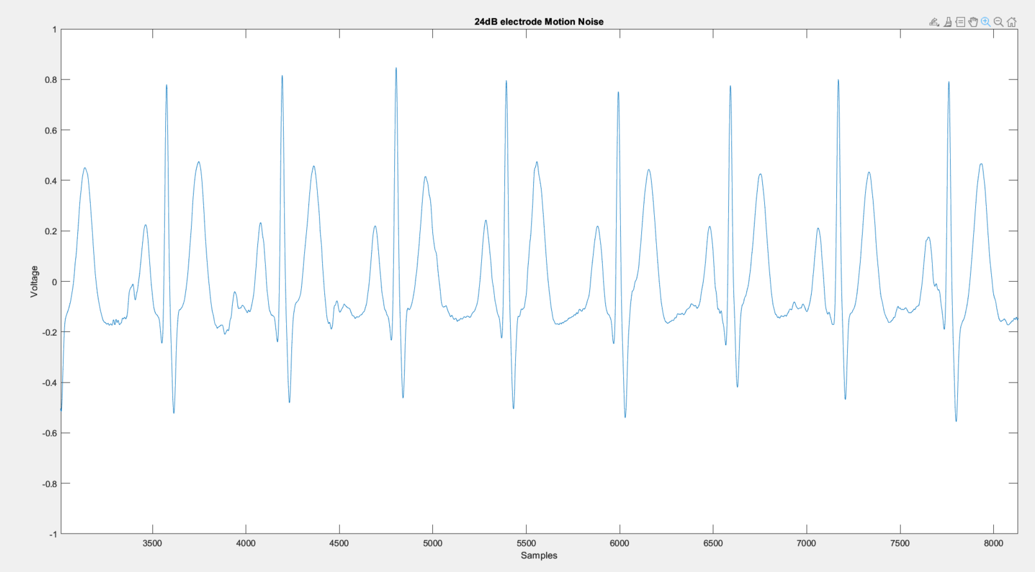
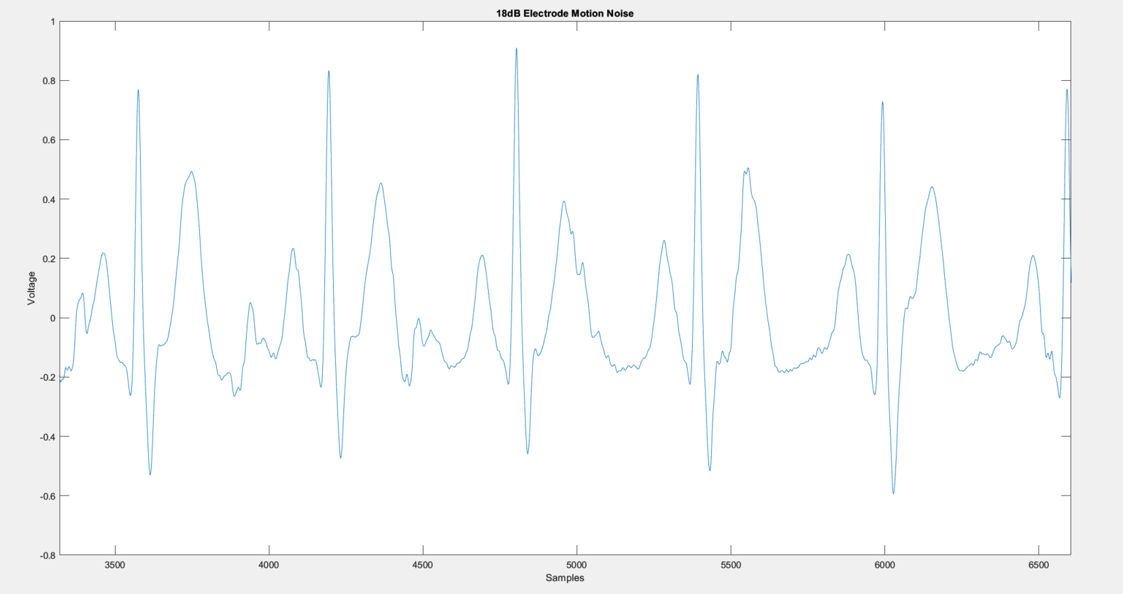
Database Examples (Noise Signals)
These plots show the original noise signal extracted and scaled to five different SNR.
These plots only show the original noise signal extracted from the Physionet NST-DB. (No AR modelling)

Slide 6
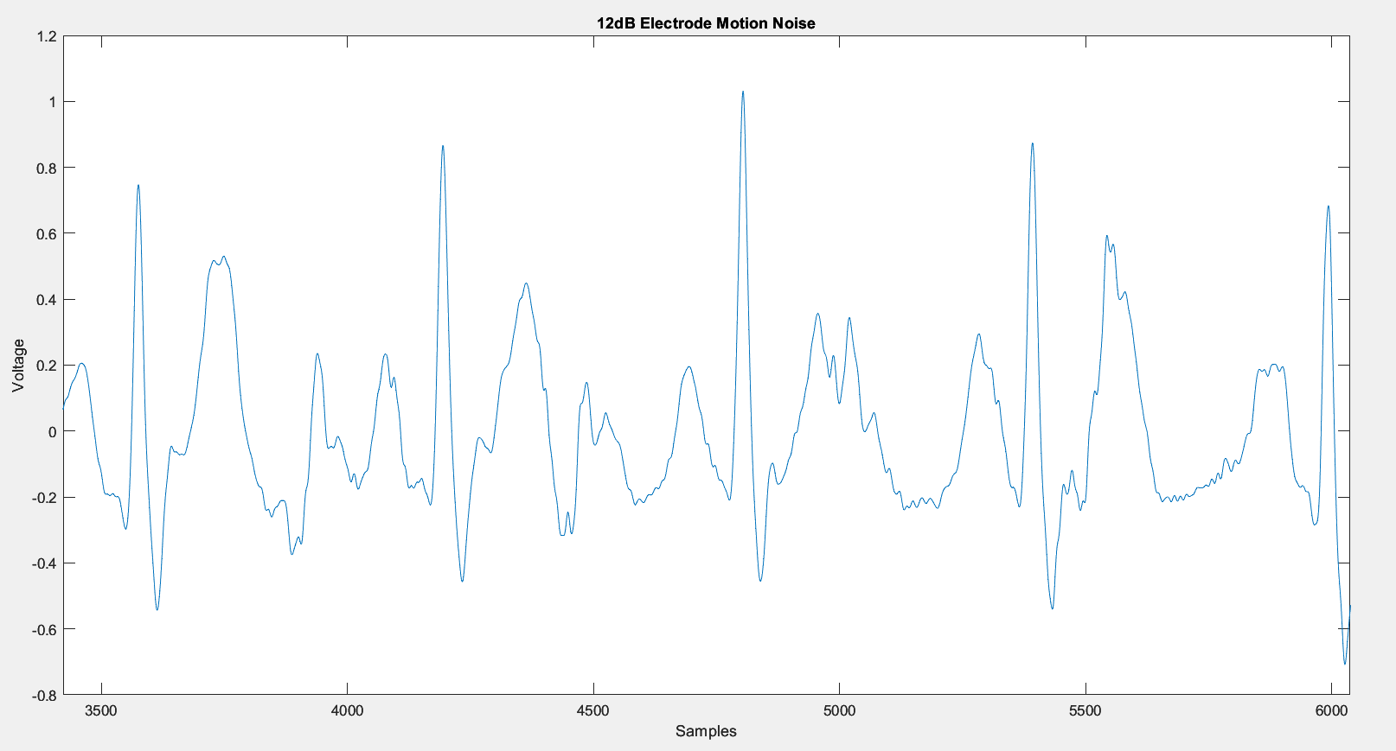
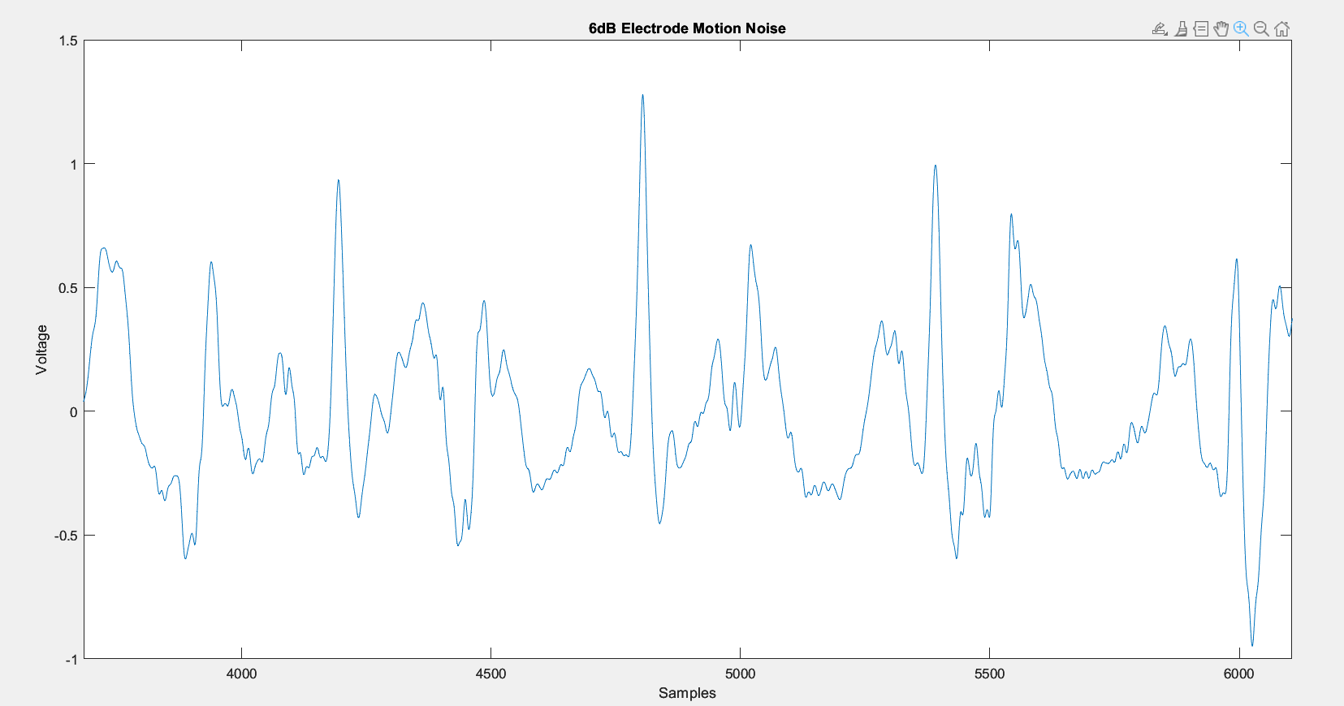
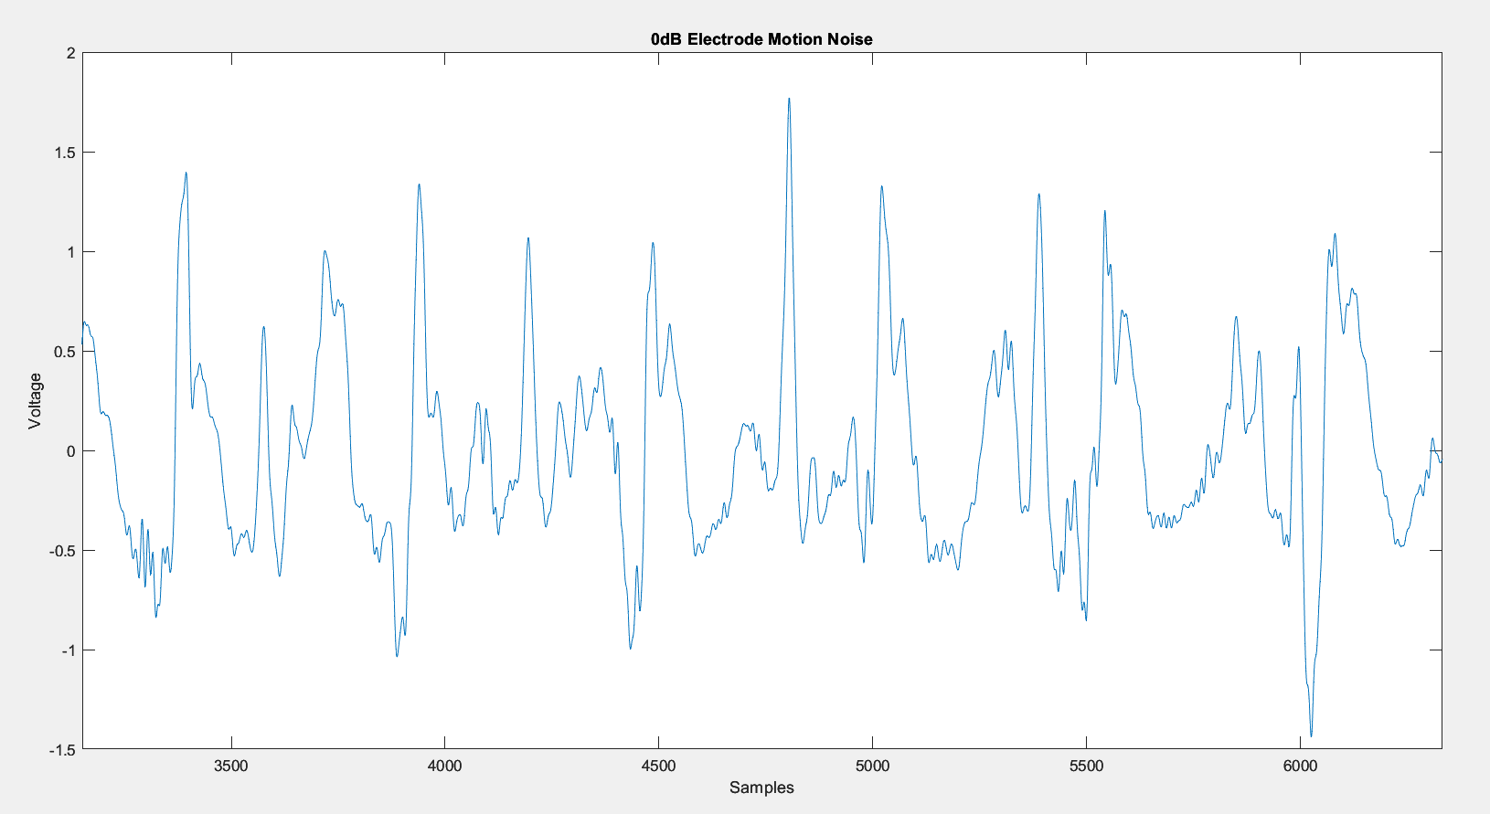
Database Examples (Noise Signals)

Slide 7
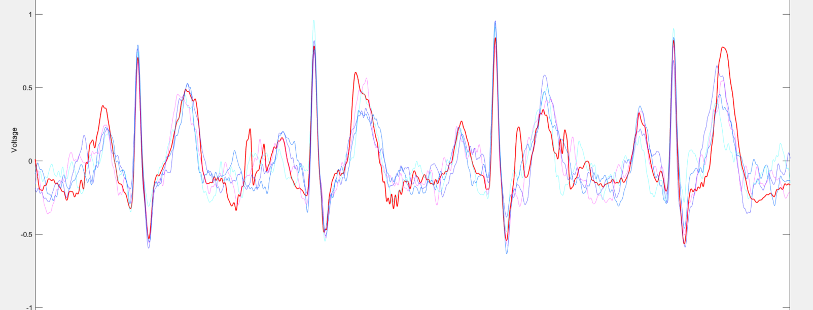
Database Examples (Noise Signals – AR)
For each original noise signal, we generate 10 ‘Copies’ using AR modelling.
Figure shows 12dB original noise signal (RED) alongside 4 modelled noise signals.

Slide 8
Next Steps (Transfer Learning)
Not complete
Train the CNN developed by Dublin University on my revised dataset and investigate results
Significant effort pre-processing the database to ensure it is in the same format the university used.
Significant time required loading in database and training the network.
Aim to have visual results W.C 19th July 2024.

